Slide 1
UNIVERSITY HIGH SCHOOL
Rising 9th Grade Course Selection
Welcome

Slide 2
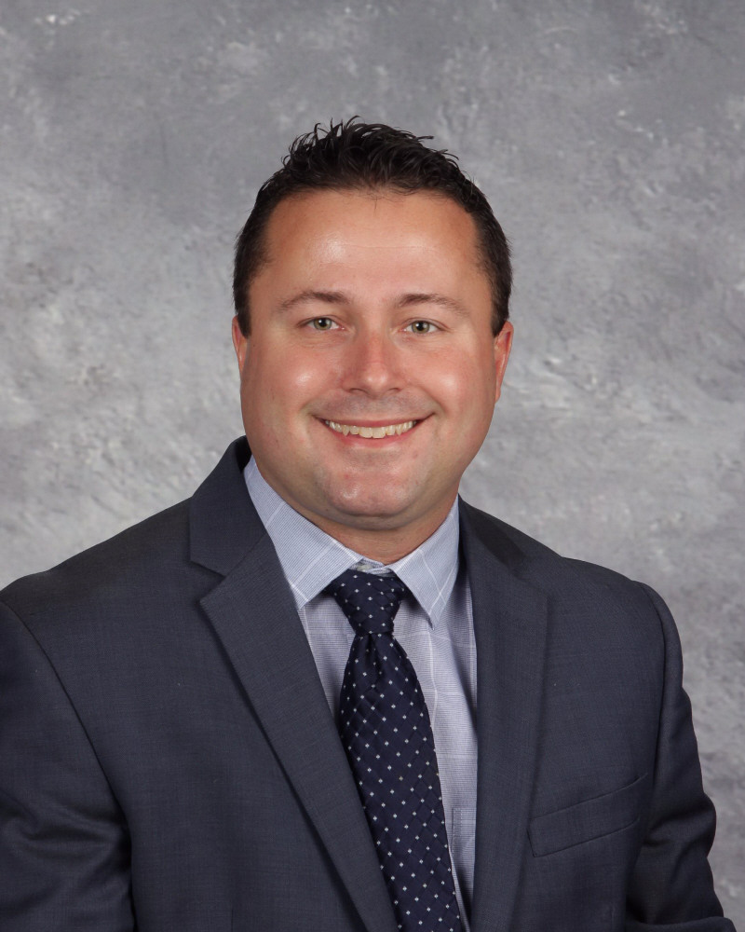
Hello Future Cougars!
Welcome the
Class of 2028!
Mr. Ott - Principal

Slide 3
Counselor Alpha Breakdown
A - DOR Mrs. Lineburgh
DOS - L Ms. Walker
M-RIVA Mrs. Chévere
RIVE - Z Mrs. Brotherson
IB & PFA Mr. Jennings

Slide 4
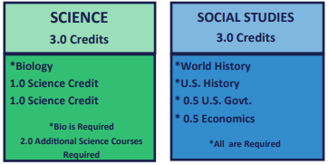
Graduation Requirements - Core Credits

Slide 5
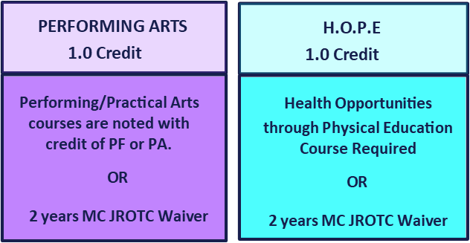
Graduation Requirements - Additional Credits

Slide 6
International Baccalaureate
Vision Statement
To be the top producer of successful students in the nation and empower them to lead with integrity, to open minds, and to transform the world.
Mission Statement
To lead our students to success and to develop international-minded lifelong learners who are collaborative, communicative, and respectful by fostering a safe environment that promotes inquiry through holistic learning.
IB Diploma Programme
The International Baccalaureate Program at University High School includes the 9th and 10th grade Pre-IB Program and the 11th and 12th grade IB Diploma Program.
Magnet: International Baccalaureate APPLY BY FEB 15

Slide 7
Performing Fine Arts Magnet The University High School Performing Fine Arts Magnet immerses students from across Orange County into a comprehensive performance-based curriculum. The program develops creative thinking as an artist, confidence in performance, and prepares students for college auditions, should they continue in that direction.
Students in the Performing Arts Magnet select one of four tracks:
The Vocal Track is for singers who will be joining our nationally recognized choral program.
The Theatrical Track is for performers who wish to focus on our drama program.
The Instrumental Track includes our award-winning Band, Orchestra, Piano, and Guitar programs.
The Dance Track features both modern and traditional dance styles and techniques.
Performing Arts Magnet students are eligible for two performing ensembles each year, as well as a third elective to go deeper, focusing on music theory, stagecraft, musical theater, and more.
Magnet: Performing Fine Arts APPLY BY FEB 15

Slide 8
License Practical Nursing Program

Slide 9
Program Requirements
Length: 4 school years (including 2 summers)
Schedule Requirements:
9th and 10th grade: 1 class period per day
11th and 12th grade: 3 class periods per day
2 Summer School Sessions required between 10th and 11th grade AND between 11th and 12th grade (each summer will require approximately 4-6 weeks of school)
Students must attend a mandatory orientation before
the start of the program (the week before school begins)
Clinicals will happen between the spring of junior year
and the end of senior year

Slide 10
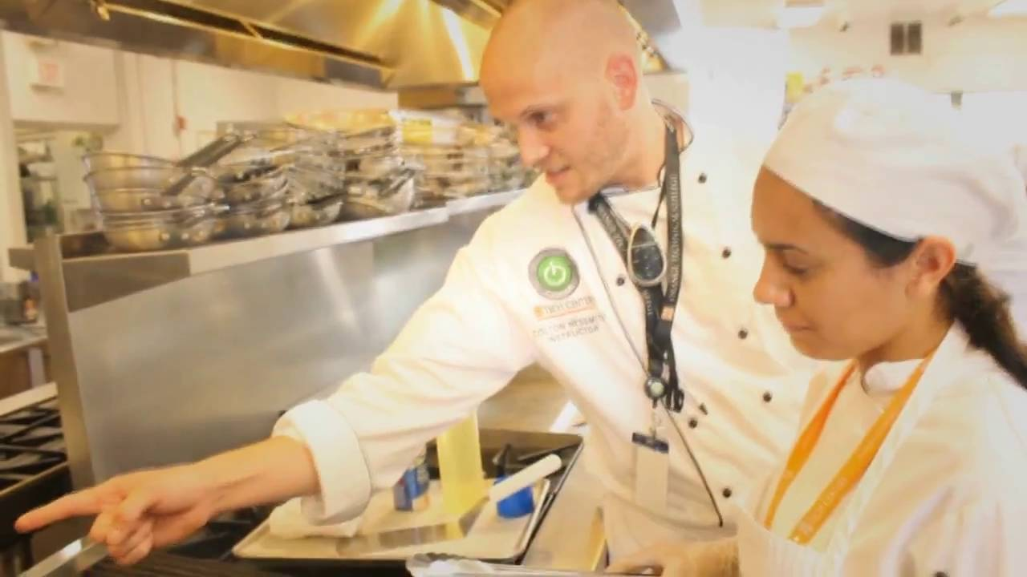

Slide 11
Program Requirements
U
Length: 3 school years
Schedule Requirements:
9th and 10th grade: 1 class period per day
11th grade: 3 class periods per day
This program offers a sequence of courses that provides coherent and relevant commercial food service knowledge and skills needed to prepare for further education and careers in the Hospitality & Tourism career cluster;

Slide 12
Digital Video Videography
Course Selection: RTV0015 Digital Video Videography
Certification(s) Available: Adobe Certified Associate (ACA) Premiere Pro, ACA Photoshop
The Digital Video Technology program also prepares students for initial employment as studio assistants and edit technicians, video editors. Training includes: digital video fundamentals, lighting, video camera operation, electronic news gathering and field production, video editing, control room operation, audio recording, preproduction and post production, scriptwriting, and digital video production technology. Communication, human relations, leadership and employability skills, industry protocol and safe and efficient work practices are integral parts of the training.

Slide 13
Program Requirements
Length: 3 school years
Schedule Requirements:
9th and 10th grade: 1 class period per day
11th grade: 3 class periods per day
The Digital Video Technology program also prepares students for initial employment as studio assistants and edit technicians, video editors. Training includes: digital video fundamentals, lighting, video camera operation, electronic news gathering and field production, video editing, control room operation, audio recording, preproduction and post production, scriptwriting, and digital video production technology. Communication, human relations, leadership and employability skills, industry protocol and safe and efficient work practices are integral parts of the training.

Slide 14
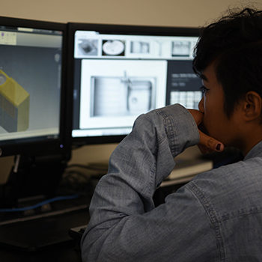
Course Selection: 8600550 Introduction to Eng Design
Students dig deep into the engineering design process, applying math, science, and engineering standards to hands-on projects. They work both individually and in teams to design solutions to a variety of problems using 3-D modeling software, and use an engineering notebook to document their work.
Affordable housing design. Biofuel production. App development. These are all hands-on, real-world challenges students face in their PLTW Engineering courses. Throughout the program, students step into the varied roles engineers play in our society, discover new career paths and possibilities, and develop engineering knowledge and skills. In addition, as students work in teams to design and test solutions, they’re empowered develop in-demand, transportable skills like collaboration, critical thinking, and communication.
Project Lead The Way Engineering Program

Slide 15
Course Selection: 8209510 Digital Design 1
Certification(s) Available: Adobe Photoshop, Adobe InDesign and Adobe Illustrator
Digital Design is an art and design course intended to introduce students to the industry-level software Adobe Photoshop, Adobe InDesign and Adobe Illustrator and make them experts in it as well as to explore graphic design and the career opportunities that it offers.
Digital Design

Slide 16
Course Selection: 8106810 Agriscience Foundations 1
Certification(s) Available: Agriculture Associate Certification (AAC)
Agriculture, Food and Natural Resources career cluster; provides technical skill proficiency, and includes competency-based applied learning that contributes to the academic knowledge, higher-order reasoning and problem-solving skills, work attitudes, general employability skills, technical skills, and occupation-specific skills, and knowledge of all aspects of the Agriculture, Food and Natural Resources career cluster.
Course Selection: 8111510 Veterinary Assisting 1
Certification(s) Available: Certified Veterinary Assistant (CVA), Animal Care Technologies
The Veterinary Assisting program is divided into three courses: Animal Care Giver, Kennel Tech and Veterinary Assistant. Training stresses understanding and performing the basics in the animal industry and or a veterinary hospital: Students with a grade average of 80% upon the completion of the second course are eligible for external work experience. All students must complete an external work experience in order to qualify for their industry certification Certified Veterinary Assistant (CVA).
Agricultural Communications/Veterinary Assisting Program

Slide 17
English: English 1/English 1 Hon
Math: ALG 1a/ALG 1/GEO/ALG 2
Science: Env Sci/Biology/Biology Hon
History: Psychology/AP Human Geo
PE Requirement: HOPE/JROTC
Elective:
Elective:
Typical Freshman Schedule

Slide 18
Elective: World Language
Two years of world language is NOT required to graduate.
Required Enter a four year State University
Required Florida Bright Future Scholarship
Used in Clearinghouse-NCAA
Elective: Art (Theatre, Chorus, Band, Drawing)
1 credit of Performing/Fine Arts is required for graduation
Elective: CTE Pathway
Use this course for career exploration
Suggested Freshman Courses

Slide 19
Next Steps…

Slide 20
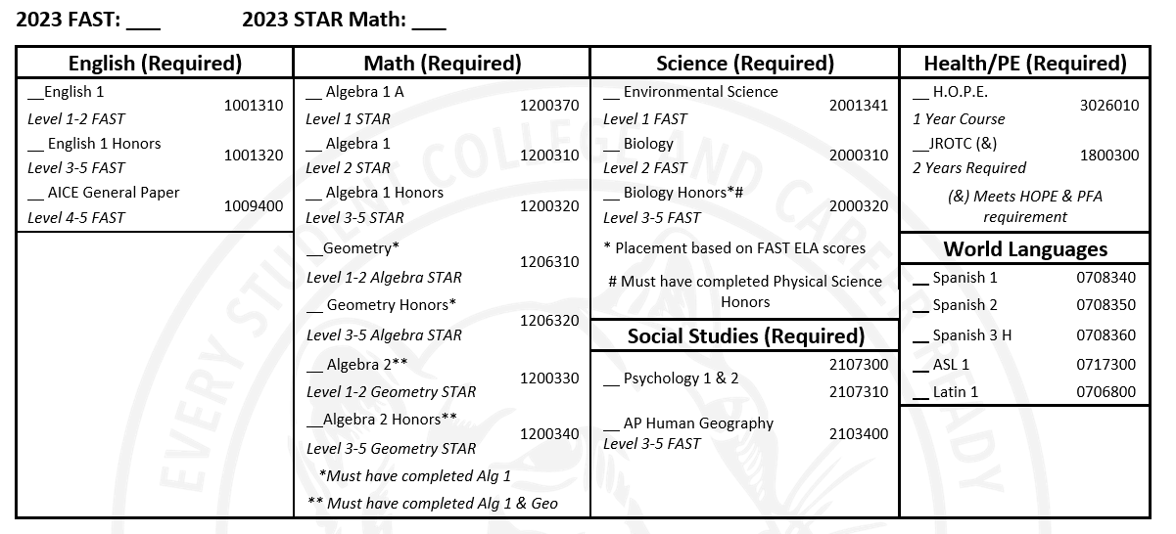
Core Coursework

Slide 21
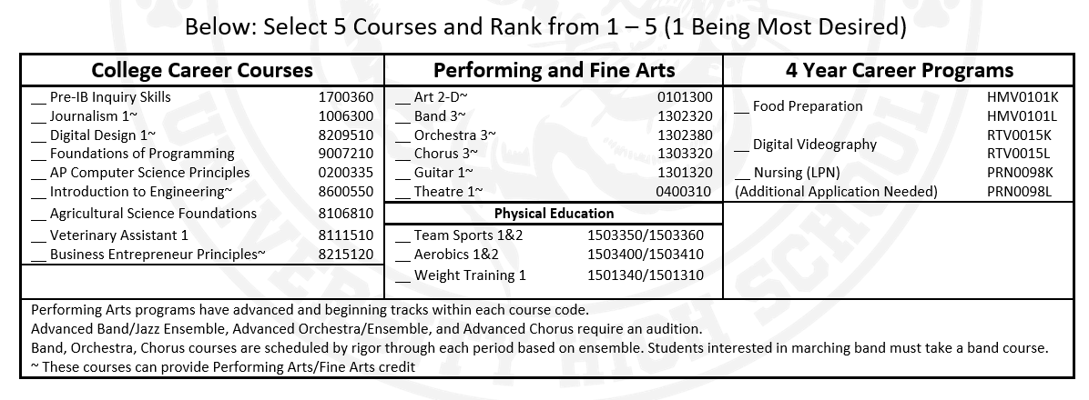
Elective Coursework
1
3
2
4
5

Slide 22
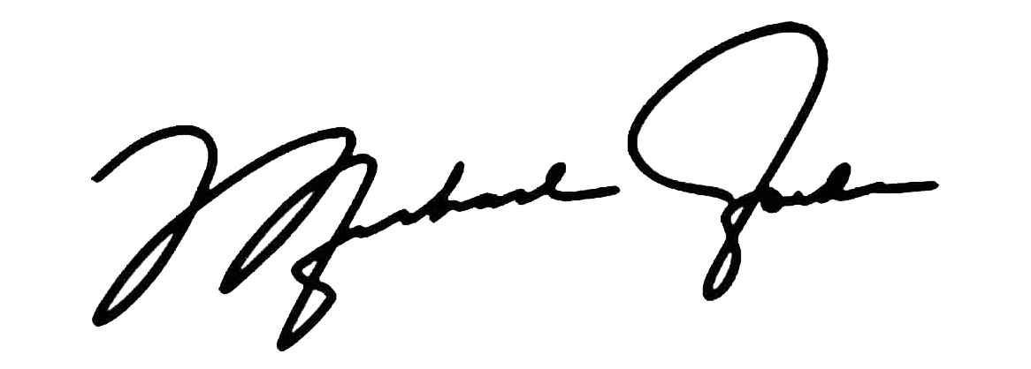
Certification Statement

